Slide 1
Cookbook for Practice 2.6
实践2.6攻略
Cong Li 李聪

Slide 2

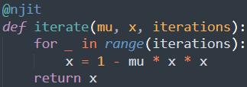
JIT Compilation 即时编译 (1)
Duplicate ‘simply.py’ as ‘simple_njit.py’
将’simply.py’复制为’simple_njit.py’
Import ‘njit’ from the ‘numba’ library
从’numba’库中导入’njit’
Then define a function for iterative calculation & decorate it for just-in-time compilation using ‘njit’
随即定义一个迭代计算的函数，并用’njit’标饰为即时编译

Slide 3

JIT Compilation 即时编译 (2)
Call the function w/ a light load to trigger compilation
用一个小型的工作负载调用该函数，触发即时编译

Slide 4

Iterative Calculation 迭代计算
Change the formal iterative calculation
将程序中正式的迭代计算
to the function call
改为函数调用
Run it 运行之
python simple_njit.py

Slide 5
The End

